Slide 1
Substation and Distribution Automation
Module 6: Volt-VAR optimization

Slide 2
Module 6 Overview
Part 1: Traditional Voltage Control
Part 2: Volt-VAR Optimization

Slide 3
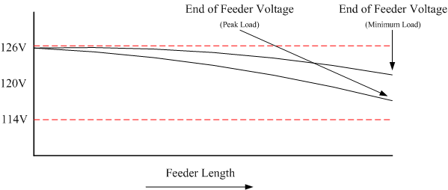
Part 1: Traditional Voltage Control
The voltage supplied to the customer is generally maintained within the limits set by ANSI C84.1, 120V +/-5%.
This is done by setting the voltage at the “head” of the feeder at the high end of the band, to ensure that the voltage drop at peak load does not exceed limits.

Slide 4
Traditional Voltage Control Cont. (Regulators)
Regulators are often installed at the substation in order to adjust the voltage at the head of the feeder.

Slide 5
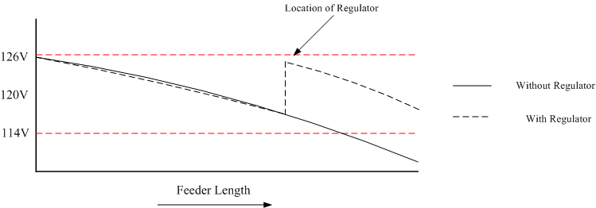
Traditional Voltage Control Cont. (Regulators)
In extreme cases a down stream voltage regulator can be installed.

Slide 6
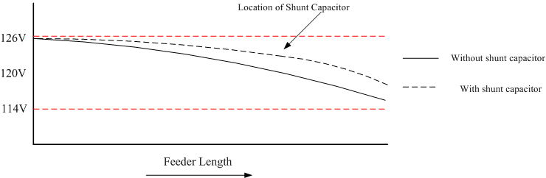
Traditional Voltage Control (Capacitors)
If the feeder is heavily loaded then a shunt capacitor can be installed to raise the voltage.
This also reduces the reactive power needs of the feeder, reducing losses.

Slide 7
Operation of Voltage Control Devices
Voltage control devices, both regulators and shunt capacitors, traditionally have been operated in a stand alone mode.
Operation is achieved through manual operation, local set points, and on occasion remote measurements.
While the set points may be coordinated, it is a static coordination and does not account for time dependant variations in the system behavior.

Slide 8
Part 2: Volt-VAR Optimization
In contrast to the traditional operational methods, Volt-VAR Optimization controls multiple devices to achieve a global optimum.
Volt-VAR Optimization, and the associated global optimum(s), exists in many forms.
The general principle is to control the voltage and reactive power on a distribution feeder so that load can be managed.
One example of VVO:
Voltage optimization involves “flattening” the voltage profile and possibly lowering the level.
VAR optimization involves controlling the flow of reactive power, which has an impact on voltage.

Slide 9
Volt-VAR Optimization
Voltage Reduction
When lowering the voltage it is necessary to ensure that the voltage on all points of the system remain within specifications.
The use of End Of Line (EOL) measurements can help to ensure that voltages at remote points are not too low.
This is similar to operating a regulator in “REMOTE” except that there can be multiple measurement points.
VAR Optimization
When capacitors operate based on local readings there is no regard for the rest of the system.
VAR optimization allows capacitors to work in a coordinate manner to reduce overall reactive power flows, thus reducing system losses.

Slide 10
Volt-VAR Optimization Cont.
There are numerous Volt-VAR optimization options commercially available:
General Electric: Coordinated Volt-VAR Control
Cooper: Integrated Volt VAR Control
ABB: Volt VAR Optimization
PCS UtiliData: AdaptiVolt
The capabilities and cost of these commercially available products varies.
There are also numerous academic papers on the topic. We will examine the following method:
“V. Borozan, M. Baran, and D. Novosel, “Integrated Volt/VAR Control in Distribution Systems”, IEEE PES Winter Meeting, 2001.”

Slide 11
Borozan, Baran, and Novosel Implementation
Simple control scheme
Works for radial feeders
No “cross branch” optimization – each “regulator branch” handled independently
No downstream coordination – branches with multiple regulators may have voltage violations while things move
Assumes no reverse energy power flow
Two-stage process
Primary goal: optimize voltage – move the voltage to a desired set point
Secondary goal: optimize reactive power – switch capacitors to maintain power factor

Slide 12
Borozan, Baran, and Novosel Implementation Cont.
Stage 1: Voltage Optimization Objectives
Determine the minimum voltage
Determine “state of the system”
Command regulators
Stage 2: Reactive Power Optimization Objectives
Determine reactive power value
Find next capacitor to switch
Command capacitors

Slide 13
Borozan, Baran, and Novosel VVO Control Procedure
Voltage Optimization
Reactive Power Optimization
Determine minimum measured voltage.
Compute the voltage drop between regulator and minimum voltage point.
Apply voltage drop to desired voltage to obtain corrected desired voltage.
Ensure corrected desired voltage does not exceed the minimum or maximum ratings
Determine if high-loading or low-loading dead band should be used.
Determine if corrected desired voltage is outside the dead band.
If tap change, ensure the estimated new voltage will not exceed the minimum and maximum values of the system
If new voltage is acceptable, change taps of regulator
Determine the reactive power on the line of interest and computer the power factor.
Determine if the power factor is below the desired power factor.
Operate capacitors as necessary to bring the power factor into the desired range.
Note: Only one capacitor is operated per cycle.

Slide 14
Voltage Optimization Procedure
Determine minimum voltage in measurements and regulator load-side voltage.
minimum voltage (V_{min}) is the lowest voltage measured associated with that regulator. It could be the load side of the regulator (regulator load-side voltage (V_{reg_load})) or an end-of-line measurement (V_{EOL}).
Compute voltage drop (V_{drop}) between regulator and minimum voltage.
Apply voltage drop to desired voltage (V_{des}) to obtain corrected desired voltage (V_{corr_des}).

Slide 15
Voltage Optimization Procedure Cont.
Ensure corrected desired voltage does not exceed the minimum or maximum ratings of the system (V_{sys_min} or V_{sys_max}):
Determine if in high-loading or low-loading deadband (V_{deadband}) conditions by examining voltage drop.
Tap-changing conditions can be determined based on a high or low load voltage drop condition
Under high loading, the voltage may need to be constrained more
e.g., a high loading condition may have:
a low loading may have:
V_{tap} is the ideal voltage change associated with a tap change on the regulator

Slide 16
Voltage Optimization Procedure Cont.
Determine if corrected desired voltage is outside the deadband of current set voltage (V_{curr_set})
If tap change, ensure the estimated new voltage will not exceed the minimum and maximum values of the system
V_{tapchange} is the V_{tap} in the appropriate direction (+ for tap up, - for tap down)

Slide 17
Voltage Optimization Procedure Cont.
If new voltage is acceptable, change taps of regulator
Tap change is pushed to the regulator directly, not a voltage set point (i.e., the regulator is commanded “tap up”, not “set voltage to 2500”)
Downstream regulators are not coordinated, so upstream changes may move them into a voltage violation.

Slide 18
Reactive Power Optimization Procedure
Only occurs if no regulator changes are requested
Determine reactive power (Q_{line}) on line of interest (substation transformer) – compute the current power factor (PF_{curr}) from the reactive power and real power (P_{line}) of the line
Note: that PF_{curr} and Q_{line} are treated more like power factor magnitude and reactive power magnitude. The VVO algorithm assumes normal radial feeders with predominately inductive loading (no predominately capacitive loads or reverse power flow)

Slide 19
Reactive Power Optimization Procedure Cont.
Determine if power factor is below the desired power factor (PF_{des})
If outside range, proceed through capacitors – only change one per operation cycle:
Determine capacitor size, (P_{CAP}) – adds together all phases
Sort capacitors by size, largest to smallest, closest to farthest
Switching thresholds (Q_{cap_off}, Q_{cap_on}) are determined by d_{min} and d_{max} ratio constants – create hysteresis-like condition

Slide 20
Reactive Power Optimization Procedure Cont.
If outside range, proceed through capacitors – only change one per operation cycle – dependent on state and size:
ON and
Capacitor ON and reactive power < Q_{cap_off}: switch capacitor to OFF
OFF and
Capacitor OFF and reactive power > Q_{cap_on}: switch capacitor to ON
Neither met
Proceed to next largest capacitor and continue check

Slide 21
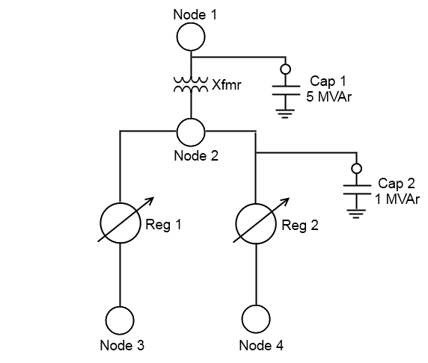
Volt-VAR Optimization – Example
Simple “4-node” system
Nodes represent measurements
Two Regulators
Two Capacitors
Assume regulators have 100 V tap positions
4700 V end of line desired
0.99 pf desired
Minimize reactive flow through Xfmr

Slide 22
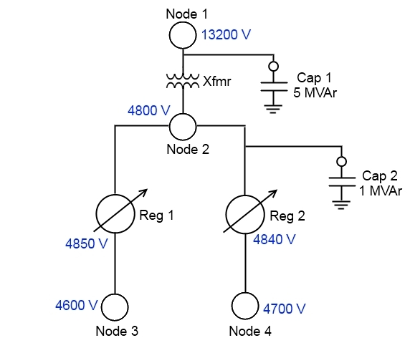
Volt-VAR Optimization Example – Initial Voltages
Determine minimum voltage and regulator load-side voltages
Reg 1 – 4850 V and 4600 V
Reg 2 – 4840 V and 4700 V
1a. Evaluate voltages
Reg 1 end-of-line voltage is low
Reg 2 is acceptable

Slide 23
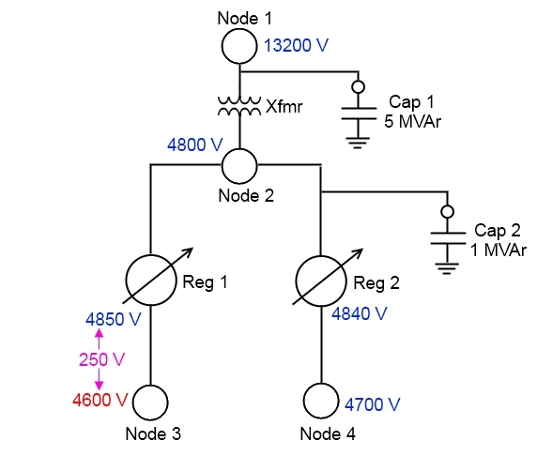
Volt-VAR Optimization Example – Condition Evaluation
Compute voltage drop between regulator and minimum voltage
Reg 1 – 250 V
Reg 2 – No action needed, but 140 V drop

Slide 24
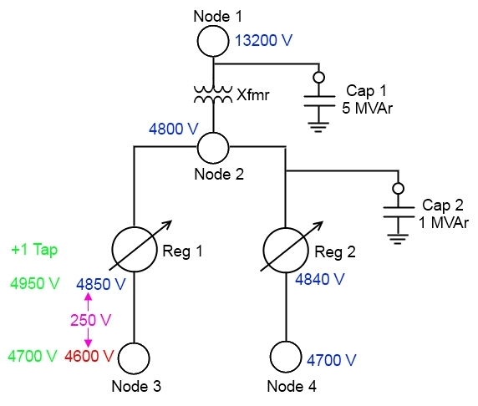
Volt-VAR Optimization Example – Corrective Actions
Corrected desired voltage for Reg 1 is 4950 V
(4700 desired + 250 V drop)
Reg 1 is assumed to have an available position to “tap up”
4950 V is assumed to not violate the upper voltage limit
250 V drop is considered high-loading
Deadband is assumed to be +/- 1 tap (+/- 100 V)

Slide 25
Volt-VAR Optimization Example – Corrective Actions Cont.
Outside the deadband of desired voltage.
+1 tap change is desired
New voltage will be 4950 V.
4850 V current + 100 V tap up
Will not violate upper voltage limit
Value of new voltage acceptable.
Execute tap change

Slide 26

Volt-VAR Optimization Example – Voltage Result
All voltages at desired values.
If the voltage at Node 3 were still unacceptable, the process would be repeated until the voltage was wither in the desired range or until regulator 1 reached the +16 tap position.
Adjustments could occur simultaneous to regulator 1 and regulator 2.

Slide 27
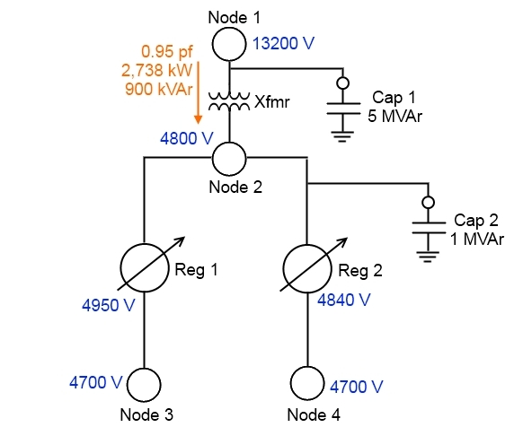
Volt-VAR Optimization Example – Reactive Power Values
Only occurs once voltage changes have completed.
Determine reactive power and compute power factor.
900 kVAr of reactive power
0.95 power factor
Determine if below desired power factor.
0.99 desired power factor, so is below (action needed)

Slide 28
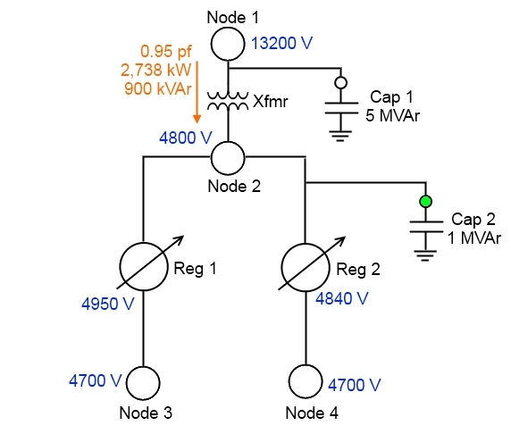
Volt-VAR Optimization Example – Reactive Power Correction
Outside range, proceed through capacitors.
Use default d_min of 0.3 and d_max of 0.6
5 MVAr capacitor
0.6 * 5 MVAr = 3.0 MVAr – too big, no action
1 MVAr capacitor
0.6 * 1 MVAr = 0.6 MVAr – under limit, switch it in

Slide 29
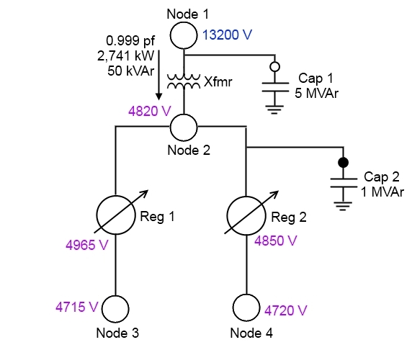
Volt-VAR Optimization Example – Reactive Power Result
Evaluate results
If no voltage changes are required, proceed then the control system will loop back to the voltage optimization procedure.
If more reactive changes required, rescan the capacitor list and determine if there are other capacitors that should be inserted.
Capacitor changes can influence voltages
May exceed voltage limits.
Can cause regulator and capacitor “fighting” in this simple algorithm.

Slide 30
Integrated Volt/VAR Control in Distribution Systems
Now we will examine a detailed example of a Volt-VAR optimization scheme.
Various simulations of the Borozan, Baran, and Novosel Volt-VAR optimization method, as executed in GridLAB-D, will now be examined.
A modified version of the IEEE-13 node test system will be used.

Slide 31
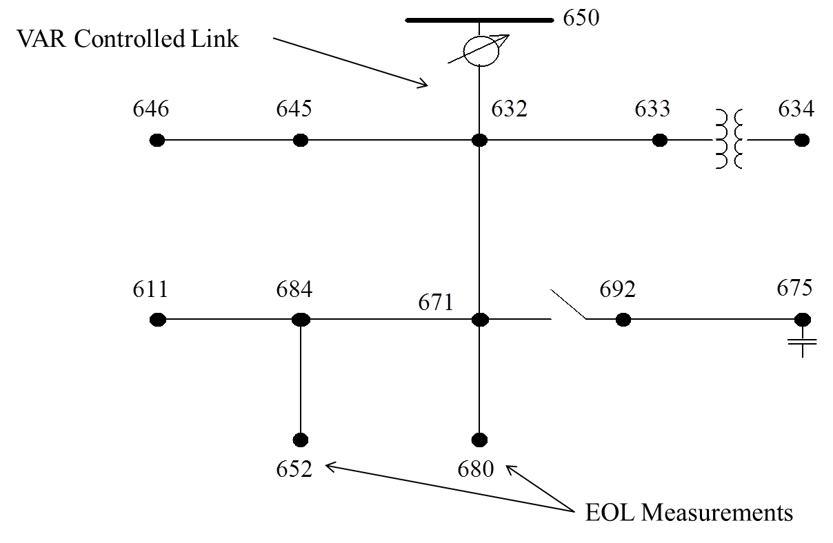
Modified IEEE 13 Node System with Volt-VAR Control
The model has been modified from the original test feeder in order to examine voltage control issues.
A voltage regulator is between node 650 and 632.
It operates to regulate the voltage at a remote node, node 671.
The normal dead band is +/- 30 V.
Capacitors have been added at node 675 to maintain the local voltage.
The ZIP models from the original test system have been replaced with a combination of ZIP loads and multi-state physical load models.

Slide 32
Volt-VAR Examples
Case 1: Comparison of voltage regulation between local control and VVO at 2,400V.
Case 2: Local voltage control
Case 3: VVO regulated to 2,400 V
Case 4: VVO regulated to 2,300 V
Case 5: VVO regulated to 2,200V

Slide 33
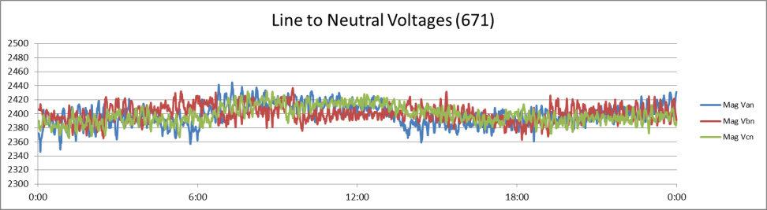
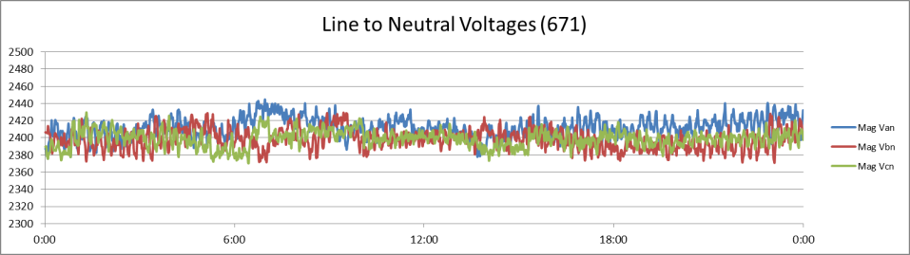
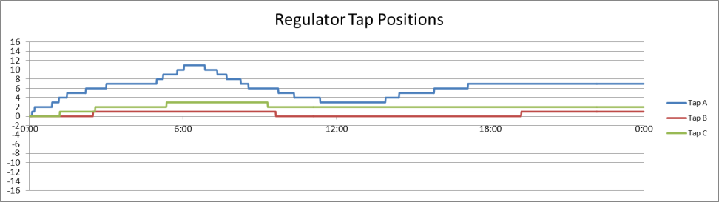
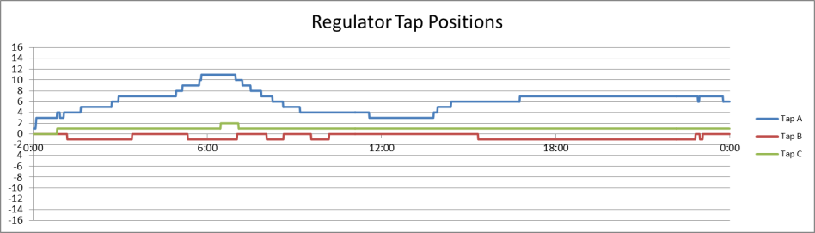






Case 1: Voltage Regulation
Local Voltage Control only
Voltage at node 671 controlled by regulator to 2,400V
Voltage at node 675 maintained by capacitors
Coordinated Volt-VAR control implemented
Voltage is regulated at nodes 652 and 680 to 2,400V
Better regulation is achieved
$$\%VR_{A}=\frac{V_{min}−V_{peak}}{V_{peak}}=\frac{2444.98−2345.83}{2345.83}=4.23\%$$
$$\%VR_{A}=\frac{V_{min}−V_{peak}}{V_{peak}}=\frac{2444.47−2376.00}{2376.00}=2.88\%$$
$$\%VR_{B}=\frac{V_{min}−V_{peak}}{V_{peak}}=\frac{2436.77−2362.80}{2362.80}=3.13\%$$
$$\%VR_{B}=\frac{V_{min}−V_{peak}}{V_{peak}}=\frac{2429.39−2371.06}{2371.06}=2.46\%$$
$$\%VR_{C}=\frac{V_{min}−V_{peak}}{V_{peak}}=\frac{2432.39−2365.38}{2365.38}=2.83\%$$
$$\%VR_{C}=\frac{V_{min}−V_{peak}}{V_{peak}}=\frac{2429.71−2370.37}{2370.37}=2.50\%$$

Slide 34
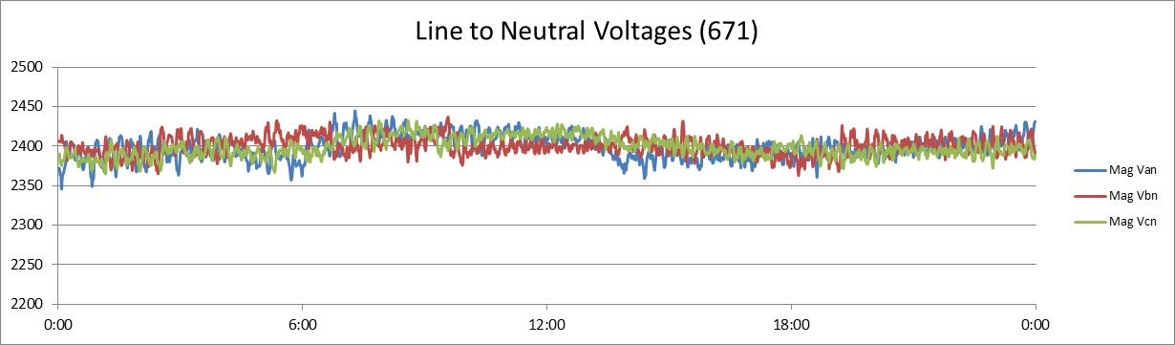
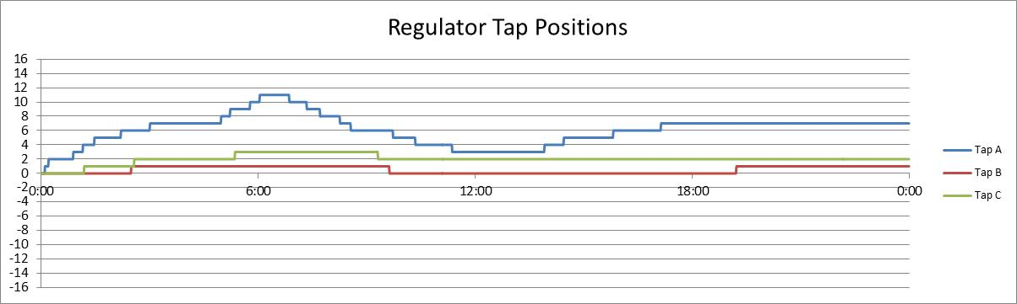
Case 2: Local Voltage Control
Voltage is regulated at node 671, to a values of 2,400V:
Energy consumption and tap changes:
P (kWh-hr) | 38,730
Q(kVAR-hr) | 7,225
S(KVA-hr) | 39,427
Phase a | 23
Phase b | 3
Phase c | 4
Regulator Tap Positions

Slide 35
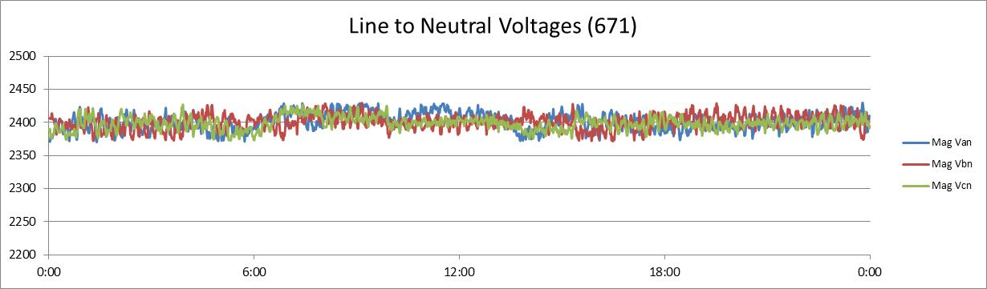
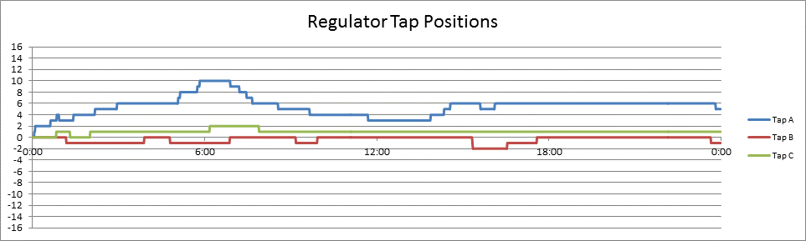
Case 3: VVO regulated to 2,400 V
Nodes 652 and 680 are the EOL measurements, with a desired value of 2,400V.
Energy consumption and tap changes:
P (kWh-hr) | 38,733
Q(kVAR-hr) | 2,004
S(KVA-hr) | 38,258
Phase a | 25
Phase b | 11
Phase c | 5
Regulator Tap Positions

Slide 36
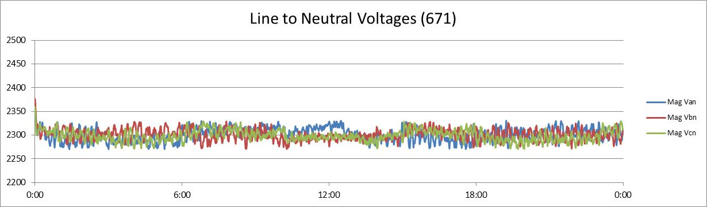
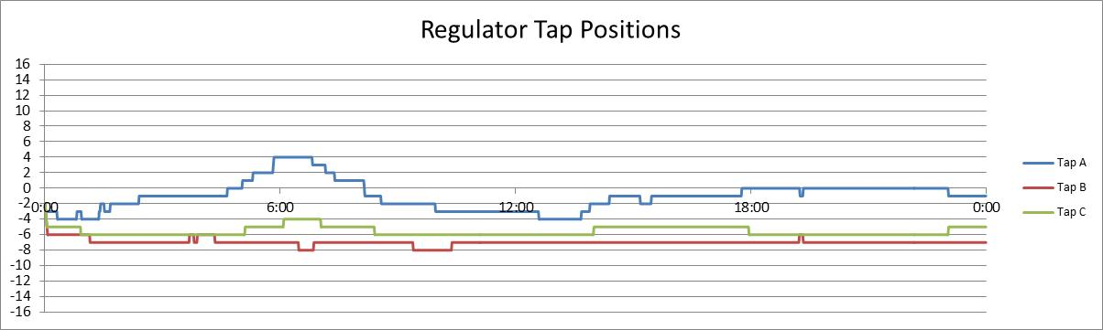
Case 4: VVO regulated to 2,300 V
Nodes 652 and 680 are the EOL measurements, with a desired value of 2,300V.
Energy consumption and tap changes:
P (kWh-hr) | 38,390
Q(kVAR-hr) | 7,390
S(KVA-hr) | 38,553
Phase a | 33
Phase b | 17
Phase c | 13
Regulator Tap Positions

Slide 37
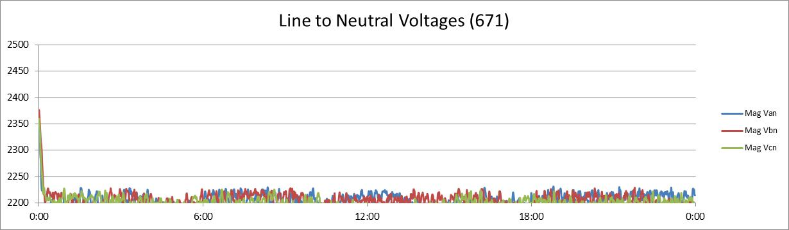
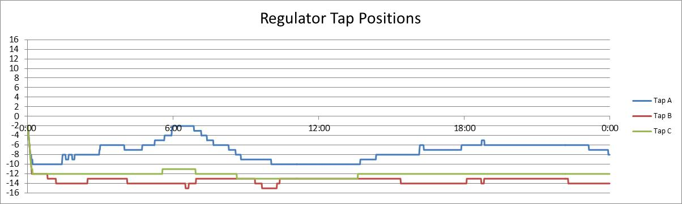
Case 5: VVO regulated to 2,200 V
Nodes 652 and 680 are the EOL measurements, with a desired value of 2,200V.
Energy consumption:
P (kWh-hr) | 38,065
Q(kVAR-hr) | 2,951
S(KVA-hr) | 38,258
Phase a | 42
Phase b | 28
Phase c | 16
Regulator Tap Positions

Slide 38
Comparison of Cases 2, 3, 4, and 5
Local Voltage Control
VVO-2,400V
VVO-2,300V
VVO-2,200V

Slide 39
VVO Optimization and Energy Reductions (Where did the load go?)
End-use loads
Primary consumption
Local losses
System losses
Overhead lines
Underground lines
Transformer losses
Series
Shunt
Triplex Losses
Parasitic losses
Non-metered utility loads
Control instrumentation
Non-technical losses

Slide 40
VVO Optimization and Energy Reductions Cont. (Where did the load go?)
End-use loads: The end use customers receive the same quality of service, but it is delivered in a more efficient manner.
System losses: System losses will generally decrease but they can sometimes decrease depending on the system. In either case, the reduction of system losses will be significantly less than the reduction of energy from the end use loads.
Parasitic losses: These will generally behave as an end use load, but they compose a small part of the total energy consumption in North America.

Slide 41
Module 6 Concluding Comments
Traditionally, voltage control at the distribution level is achieved through the use of voltage regulators and shunt capacitors operated with local information and objectives.
Volt-VAR optimization is a concept that involves operating the voltage control devices in a coordinated manner to achieve some global optimum(s).
One method was examined that was a dual objective system:
Voltage optimization to reduce energy consumption
Power factor correction to reduce losses
While this one openly available method was examined, there are many commercially available methods of VVO.

Slide 42
Substation and Distribution Automation
Conclusion of Module 6: Volt-VAR optimization

